Slide 1
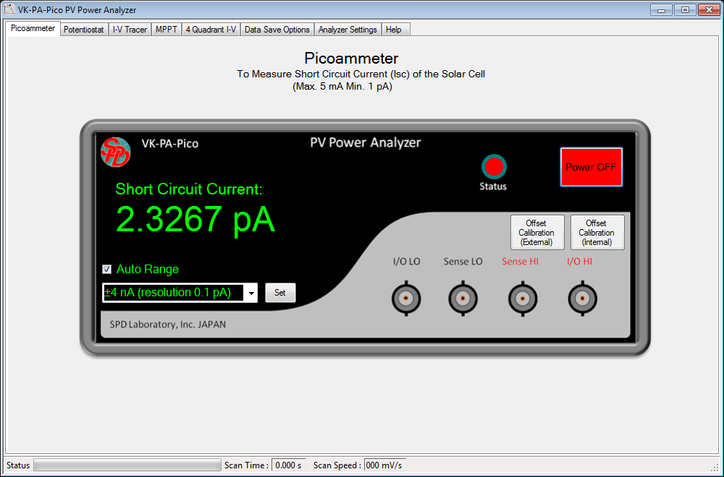
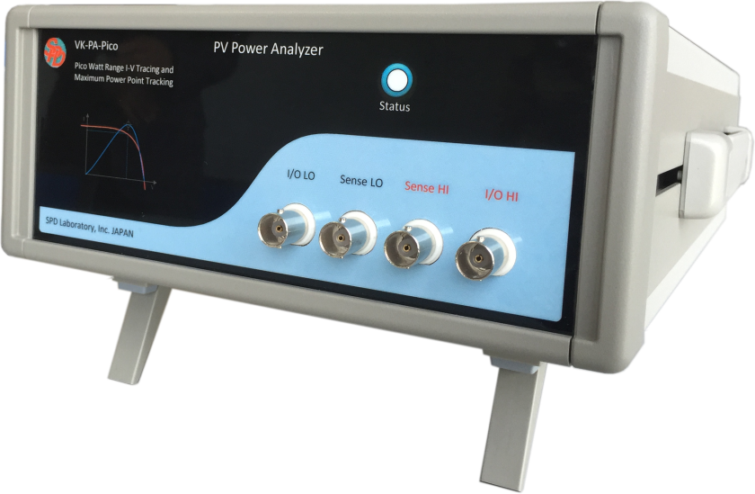
VK-PA-Pico Power Analyzer
Picoammeter Mode - Operating Principle to Measure Short Circuit Current (I_{sc}) of Solar Cell
-
Solar Cell
+
Feedback Ammeter
0 V (Short Circuit condition)
R
I
To Analog to Digital Converter
0 V

Slide 2
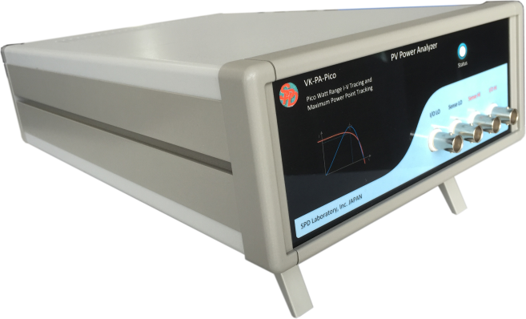
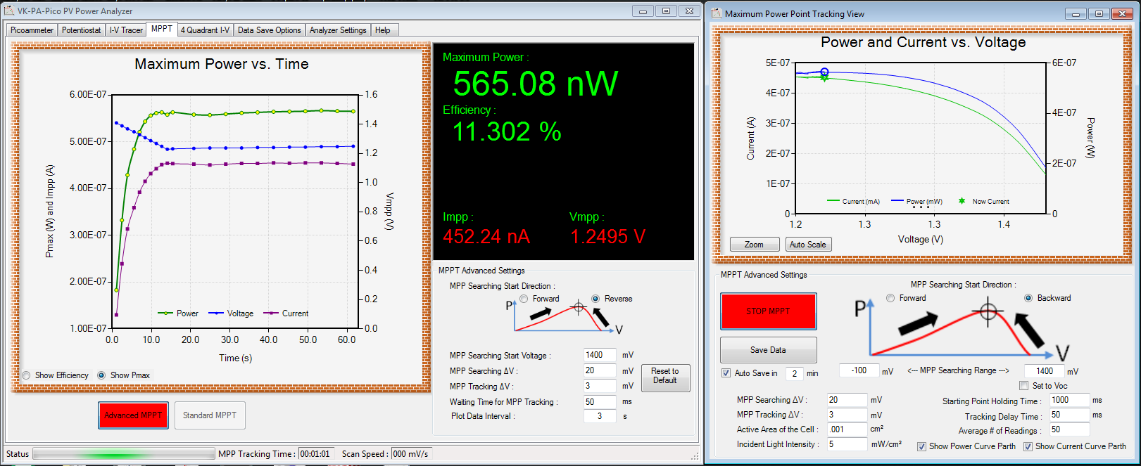
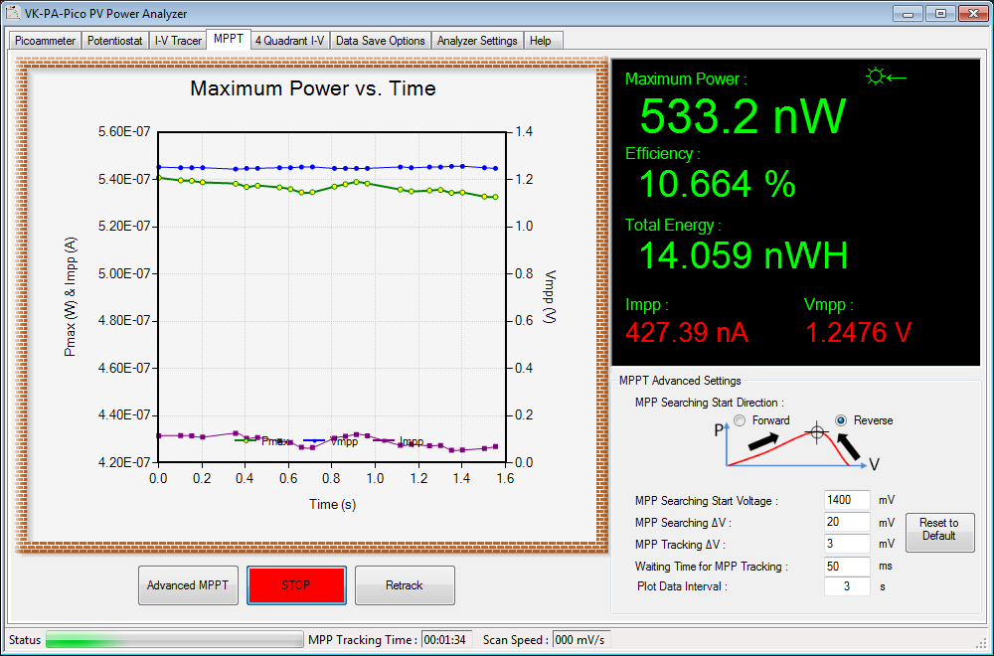
VK-PA-Pico Power Analyzer
MPPT Mode - Operating Principle
-
Solar Cell
+
Voltage Sense
Control Signal From DAC
R
I
To ADC (for Current Reading)
To ADC (for Voltage Reading)
Current Sink
Controller
I
V
Feedback Ammeter
Current Sink
ADC :- Analog to Digital Converter DAC :- Digital to Analog Converter

Slide 3
VK-PA-Pico Power Analyzer
Maximum Power Point Tracking Mechanism
S₂₋₃
S₁₋₂
P₂
P₁
P₃
Output Power
V-ΔV V V+ΔV
Output Voltage
User can set the desired ΔV value. Default value is 1 mV
If (S₁₋₂ > 0 and S₂₋₃ > 0) then
P₁ ← P₂
P₂ ← P₃
Find New P₃ at V+2ΔV
If (S₁₋₂ > 0 and S₂₋₃ < 0) then
Maximum Power Point is P2
If (S₁₋₂ < 0 and S₂₋₃ < 0) then
P₃ ← P₂
P₂ ← P₁
Find New P₁ at V-2ΔV
P₃
P₁
P₂
P₂
P₁
P₃

Slide 4
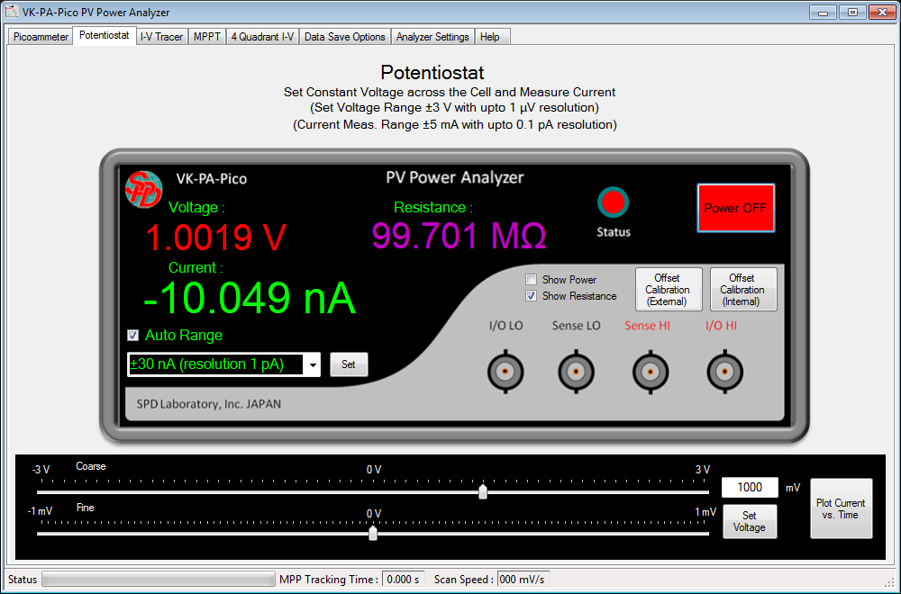
VK-PA-Pico Power Analyzer
VK-PA-Pico can also work as current source if needed. In the potentiostat mode it work as current source to the device (such as resistor or diode) connected to analyzer outputs.

